Slide 1
5 Domains of Writing

Slide 2
5 Domains of Writing
Focus
Content
Organization
Style
Conventions

Slide 3
Focus
A single controlling point made with an awareness of task about a specific topic.

Slide 4
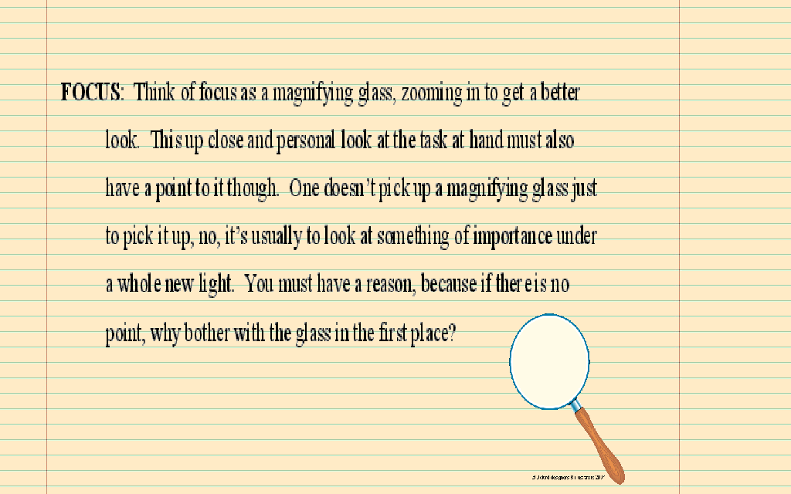

Slide 5
Strong Focus
In order to have a strong focus a writer must make a sharp, distinct controlling point about a single topic with evident awareness of task.

Slide 6
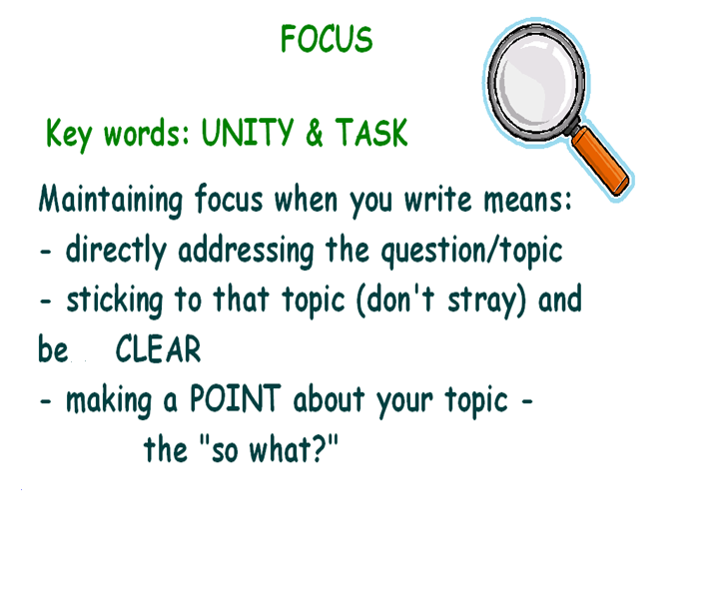

Slide 7
Outside the magnifying glass: write down phrases , words or sentences describing summer
Inside the magnifying glass: write down phrases, words or sentences describing your favorite day this summer

Slide 8
On a piece of lined paper
Write as many details as you can about a party. These can be words phrases or sentences. (keep it classy folks)
Next draw a line under your writing. Now you will focus on one of your favorite parties. Describe in detail focusing on this event only. Write in complete sentences. (still keepin it classy folks)

Slide 9
Exit Ticket
“In regards to focus, what is it important to do when writing?”

